Slide 1
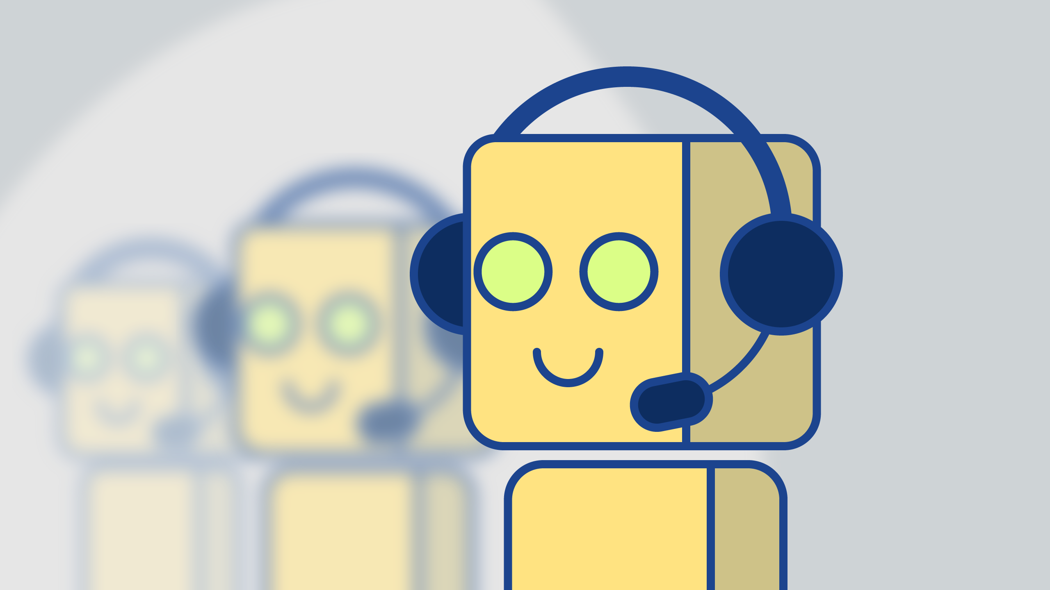
Chatbot song recommender system
- Monu Kumar Bind (11) - Ganesh gaurahari panigrahi (59) - Shubham rajaram gharl (21) -Ayush vinay Waghmare (76)

Slide 2
OUTLINE
Objective
Project context
Product architecture
High level approach
Goals
conclusion

Slide 3
Objective
In this project, we would be combining multiple services and open-source tools to make a Chatbot that recommends songs based on the tone of the conversation which the user is having with the chatbot.

Slide 4
Project context
The purpose of chat bots is to support and scale business teams in their relations with customers. It could live in any major chat applications like Facebook Messenger, Slack, Telegram, Text Messages, etc. Chatbot applications streamline interactions between people and services, enhancing customer experience. At the same time, they offer companies new opportunities to improve the customers engagement process and operational efficiency by reducing the typical cost of customer service. This project is focussed on building a custom chatbot that will be your fundamental step of the learning curve of building your own professional chatbots.
But you must be tired of the weird chat bots out there in the world which are made for mainly business purposes? In this project, we would be building an extensive Chatbot service, to which you can talk to. And talking to a chatbot wouldn't be business-driven. It would just be casual conversations. Further, on top of it, the chatbot would also be recommending songs to the user based on the tone of the user. This song recommendation feature employs the use of Last.fm API, very much similar to the popular Spotify API. Also for tone/emotion analysis of the conversation we will be using the IBM Tone Analyzer API.
Collaborating with these types of APIs is very much critical as in today's world the popular chatbots do much more than simply having a data-driven conversation; to supplement additional user-oriented features. Also the reason to choose python to build the chatbot is because python boasts a wide array of open-source libraries for chatbots, including scikit-learn and TensorFlow. It is great for small data sets and more simple analyses; also Python's libraries are much more practical.

Slide 5
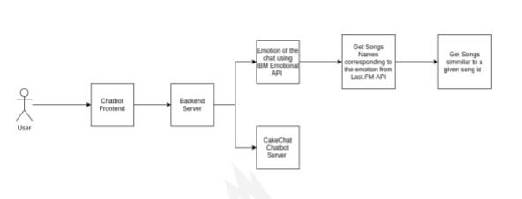
Product architecture

Slide 6
High level approach
User starts the conversation
Emotional Analysis of the conversation is done using the IBM Emotional API
Get the reply to the conversation from the Cakechat Chatbot
Based on the Emotion which the app perceives, top songs are retrieved using Last.fm songs API
If a user listens to a particular song for sometime, a similar song would be recommended to the user using last song.fm API

Slide 7
goals
User starts the conversation
Emotional Analysis of the conversation is done using the IBM Emotional API
Get the reply to the conversation from the Cakechat Chatbot
Based on the Emotion which the app perceives, top songs are retrieved using Last.fm songs API
If a user listens to a particular song for sometime, a similar song would be recommended to the user using

Slide 8
conclusion
Working Chatbot Demo IV. CONCLUSION Through the proposed project and research, we draw a conclusion that the new proposed system will help the college system by overcoming some major flaws in the already present chatbot systems. Using the above study, we can further enhance the chat bot to help the college facility cater to anyone who visits the college website. This project will alleviate the pitfalls that the staff of the college comes across during the peak times of admissions

Slide 9
THANK YOU

